Slide 1
CHIC SPHERE
Ecommerce Website

Slide 2
Mission Statement
Our mission is to offer affordable, loved styles that empower women of all ages. We believe in accessible fashion that doesn't compromise on quality.

Slide 3
Who will benefit other than the owner?
Customers
Team Members
Manufacturer / Supplier
Marketing personnel

Slide 4
What makes it a good idea (Motivation)?
Market Demand and E-commerce growth are the sole factors to go for this project. Choosing to start an online dress-selling business makes sense because lots of people prefer to shop online nowadays. The website of Chic Sphere is coming up to provide a service of customized style and personalized recommendation according to the customer’s demand. Plus, it's something I'm really interested in. So, it's like hitting two birds with one stone – meeting what people want and doing something I love.

Slide 5
CLASS DIAGRAM

Slide 6
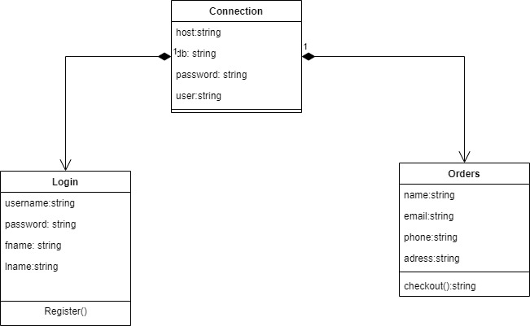

Slide 7
ENTITY RELATIONSHIP DIAGRAM

Slide 8
